Slide 1
ML-Team 5
Project Presentation

Slide 2
Scraping and Preprocessing

Slide 3
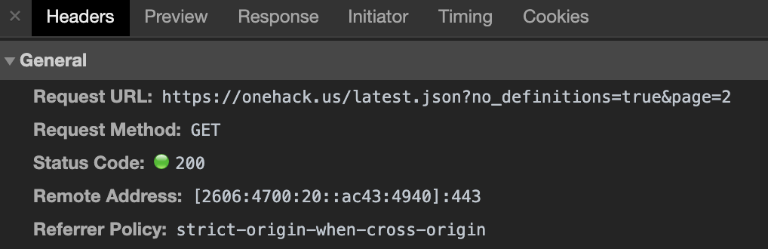
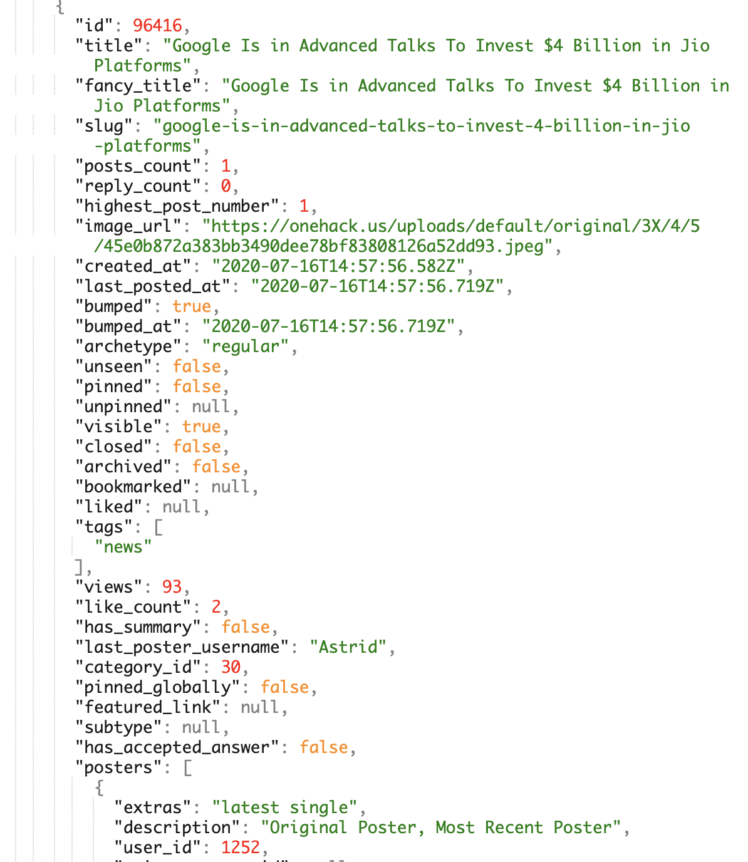
Web Scraping and Data Collection
Instead of using a web driver like selenium we took advantage of the ajax requests that the discourse forums are making.
It’s difficult to say without benchmarking but this has most likely resulted in a smaller big O.
The JSON response includes metadata that's easily accessible and parsible

Slide 4
Business Report

Slide 5

Overview of Business Report
New Zealand Bank Forum
Moderately active
1400 posts total from 2014
What we did:
Scraped forum and extracted metadata about posts
Used Google Data Studio to visualize data
Wrote a repost with in depth analysis of the forum performance

Slide 6
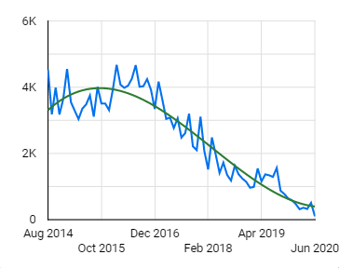
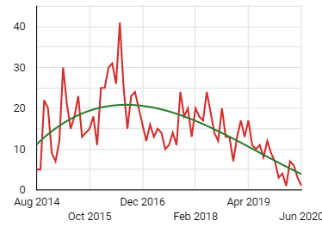
Performance Over Time
Average views per post over time
Views over time have decreased
Decrease in user engagement
Number of post per month are decreasing
Ratio of replies per post are decreasing
User engagement peaked at 2016 and has since decreased
Number of Posts vs. Post Creation Date

Slide 7
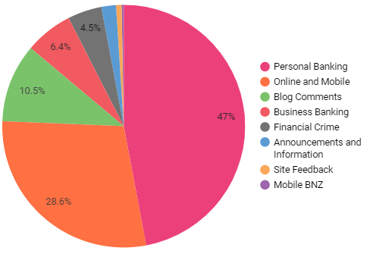
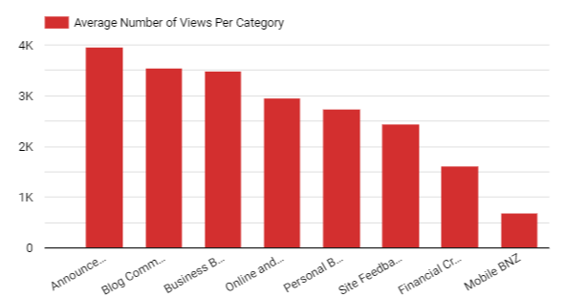
Category Performance
Personal Banking and Online and Mobile are the two categories with the most posts
Online and Mobile have the highest number of posts per topic, with Business Banking and Personal Banking second and third respectively
Announcements has the highest number of views

Slide 8
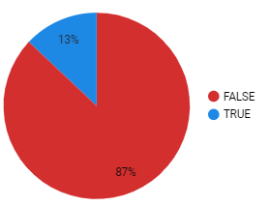
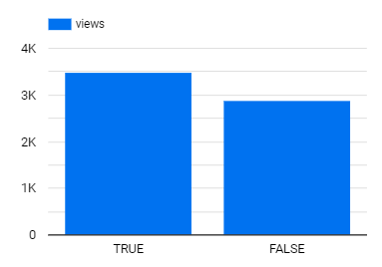
Pain Points
Posts with Tags
Limited number of posts that have tags (13%) along with categorization
Categories with a large number of posts make it harder for user to locate older topics
High ratio of posts to views = high traffic (users need to read through many posts before finding what they are searching for)
Users can forget to tag their posts
Can be remedied using Natural Language Processing (NLP) to automate the tagging process
Has accepted answer vs. Views

Slide 9
TF-IDF Text Classifier

Slide 10
Introduction
The aim here is to predict the forum that a specific post comes from.
Here we are using data from 5 different discourse forums:
Home Assist
Choice Community
1 hack
Gearbox Software
Hopscotch

Slide 11

Home Assist
It is an open source automation forum emphasising on local control and privacy.
Web scraped 472 posts

Slide 12

Choice Community
Forum for Australian consumers to get help with products and services of everyday use.
Web scraped 1999 posts.

Slide 13

1 Hack
Forum where everyone can share knowledge with each other. Provides free tutorials.
Web scraped 8446 posts.

Slide 14

Gearbox Software
Official gearbox software forum to discuss issues about the gearbox software in different games.
Web scraped 6000 posts.

Slide 15

Hopscotch
A forum dedicated to the Hopscotch app and language to help users learn coding with Hopscotch.
Web scraped 4992 posts.

Slide 16
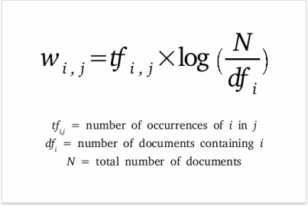
Why Tf-Idf
TF-IDF helps us understand how useful a word is to a sentence and a document. It also helps us ignore words that are misspelled.
The TF-IDF embeddings that we get help us in effectively classifying text based on the forum it is from.

Slide 17
Data Preprocessing
Remove all \n
Remove all single characters
Remove single characters from the start
Substituting multiple spaces with single space
Removing prefixed 'b'
Converting to Lowercase
Lemmatization

Slide 18
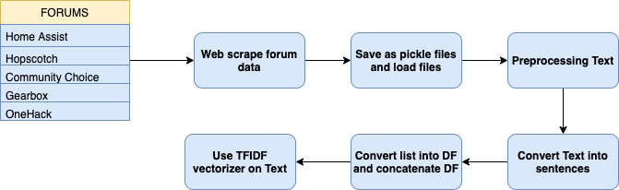
Data Preprocessing

Slide 19
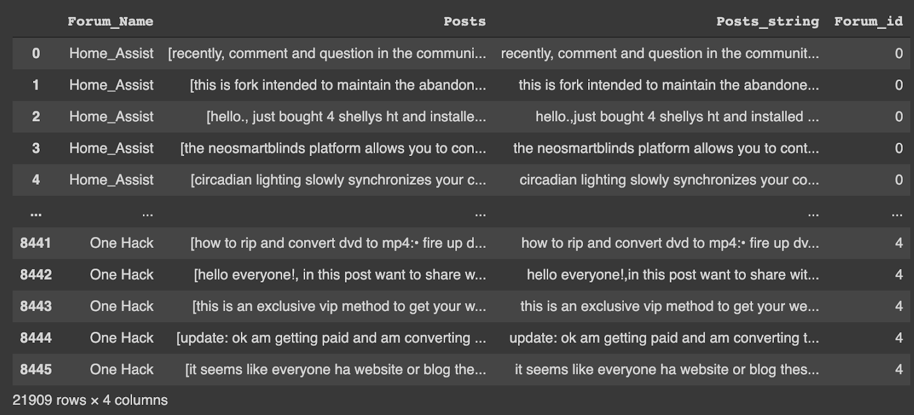
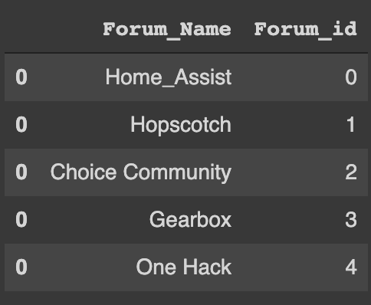
Final Dataframe

Slide 20
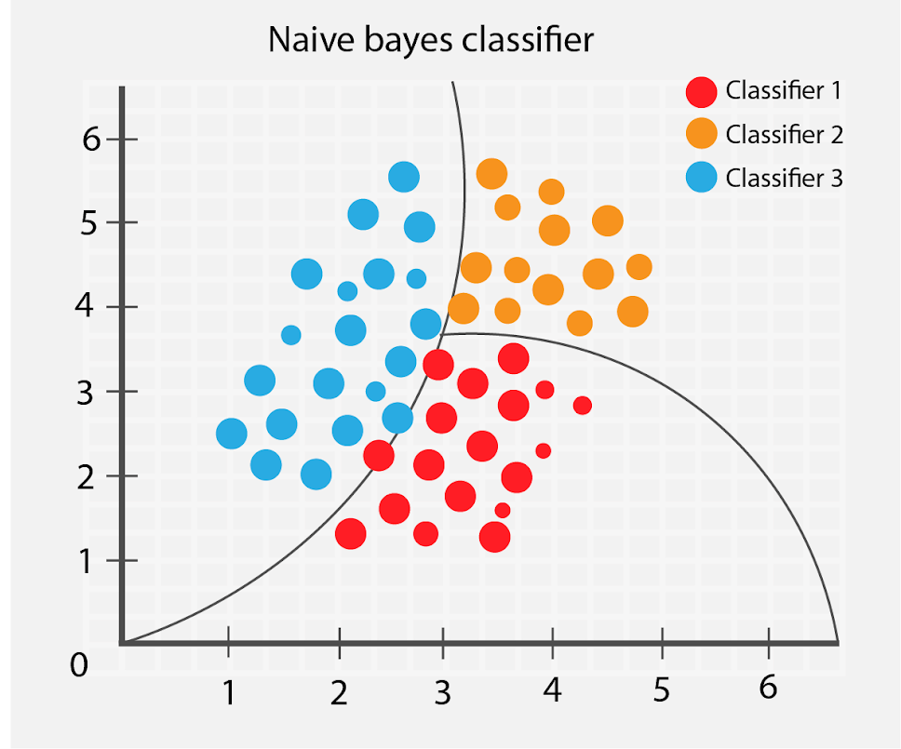
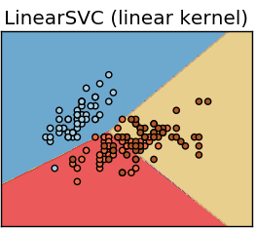
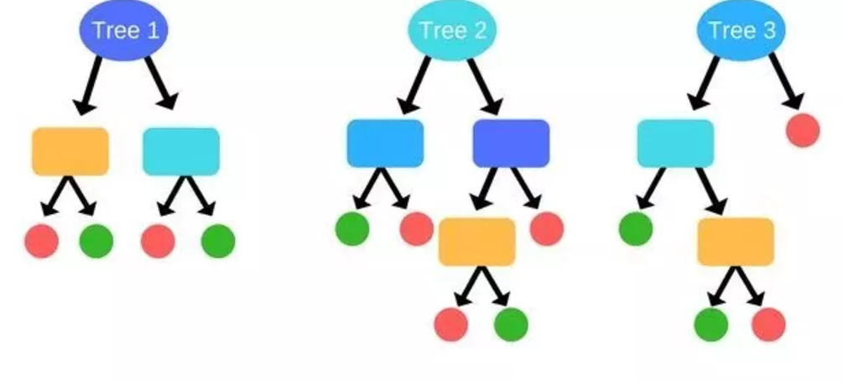
ML Models
We compared 3 Machine Learning Models.
Random Forest
Multinomial Naive Bayes
Linear SVC
The data was split in training data and testing data, into the ratio 75:25.

Slide 21
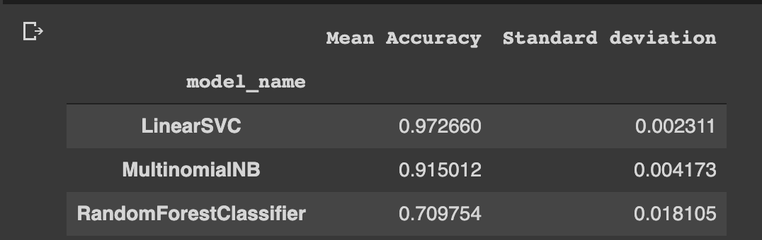
Comparing Different Predictive Models

Slide 22
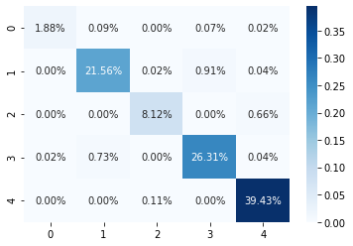
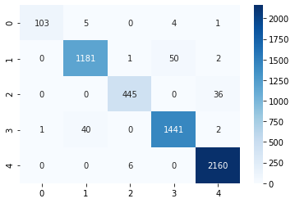
Confusion Matrix

Slide 23
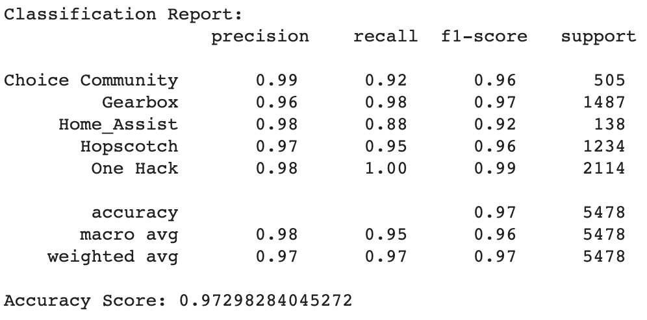
Classification Report and Accuracy Score

Slide 24
Conclusion
We used 5 discourse forums to web scrape from.
We compared 3 different ML algorithms:
RandomForestClassifier
Multinomial Naive Bayes
Linear SVC
Upon applying the Linear SVM classification algorithm the accuracy was the highest at 97% approx. MultinomialNB and Randomforest algorithms gave 91% and 70% respectively.

Slide 25
Recommendation Model

Slide 26
Description of Hopscotch
Hopscotch is a forum to discuss Hopscotch app and Language.
Video Walkthroughs, Debugging and control blocks
Helps to get started on simple coding project or participate in hackathons
Discuss our projects, tutorials and ideas for collaboration

Slide 27
Approach
Recommendation using TF-IDF Embeddings
Recommendation using BERT Embeddings
Combining both approaches
Results

Slide 28
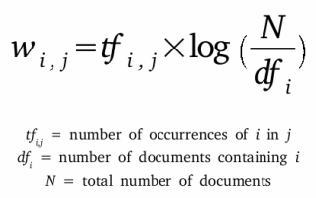
TF-IDF Approach

Slide 29
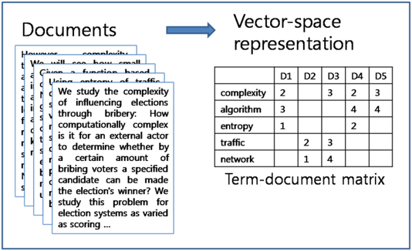
Vectorizing Text

Slide 30
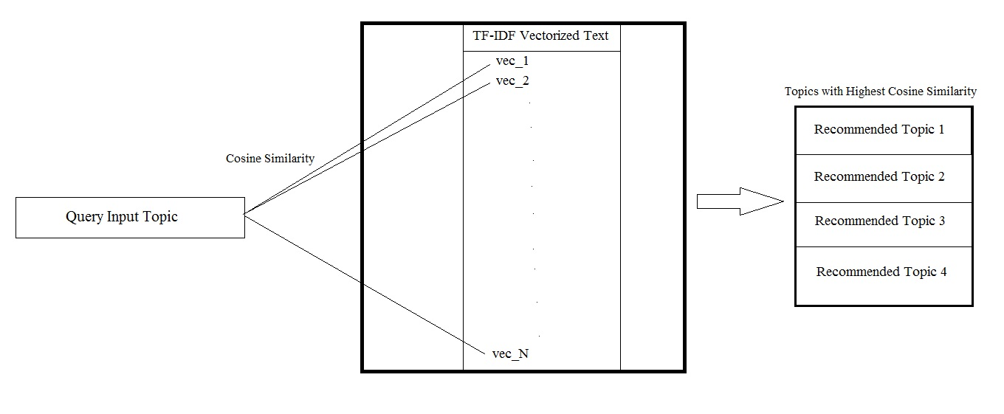
Recommendation Flow

Slide 31
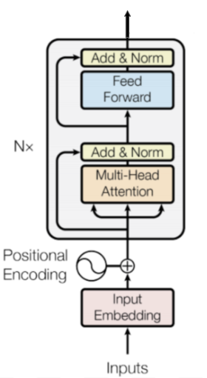
BERT Approach
Used a pre-trained BERT model for encoding sentences of input text and used them as embeddings for recommendation
BERT can extract the semantic content from words.
The dimension of the encoded representation was 768.

Slide 32
Combination Recommendation model
Combined two approaches by a weighted average of the cosine scores and performed recommendation based on the new score.
The optimal weights are 0.5 and 0.5.
Intuition was that the combined score would capture both semantic structure given by BERT and statistical structure given by TF-IDF thereby giving better recommendations.

Slide 33
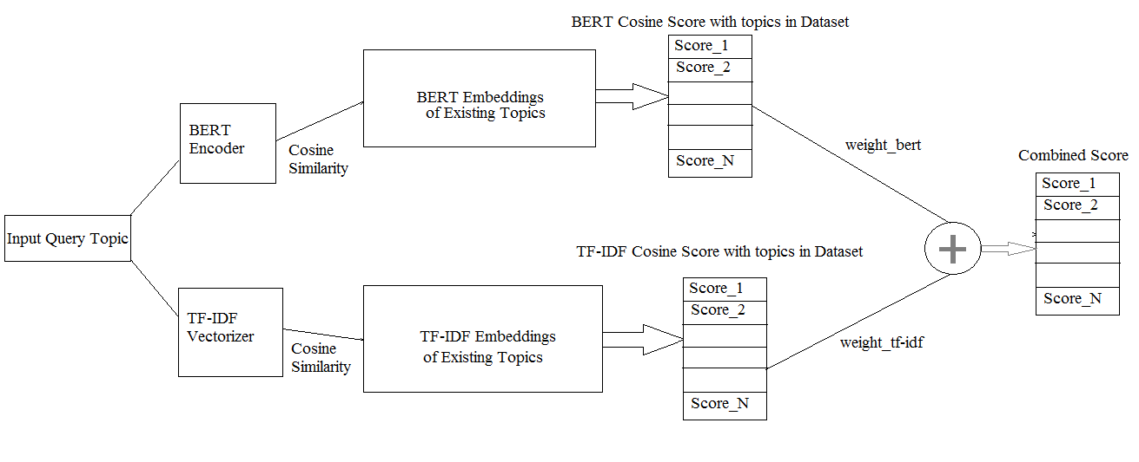
Combined Recommendation Flow

Slide 34
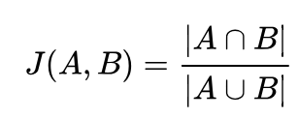
Jaccard Similarity
We use Jaccard Similarity as the benchmark to evaluate the performance of recommendation models.
Jaccard Similarity is ratio of the intersection of the input and a topic in forum to the union of them. The larger the Jaccard Similarity, the more similar they are.
We calculate the average Jaccard Similarity on the top-10 recommended topics and tune the weights.

Slide 35
Performance Analysis
The average Jaccard Similarity of the TF-IDF recommendation model is 0.071.
The average Jaccard Similarity of BERT recommendation model is 0.054.
The average Jaccard Similarity of combination recommendation model is 0.085.
The reason behind is that Jaccard Similarity basically count the common words of two topic, while TF-IDF calculating the scores in the same statistical way. Therefore, TF-IDF can obtain a better performance compared to BERT.
In the combination of TF-IDF and BERT, both of the statistical content and semantic content can be taken into account, and yield the best performance.

Slide 36
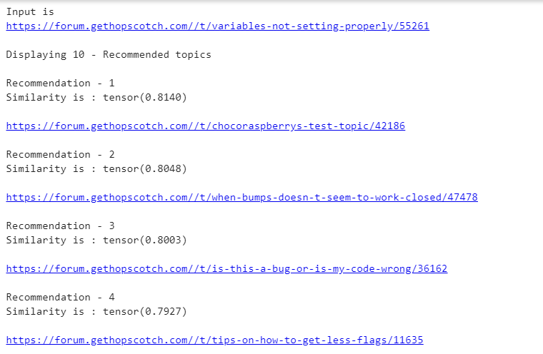
Results - BERT Recommendation

Slide 37
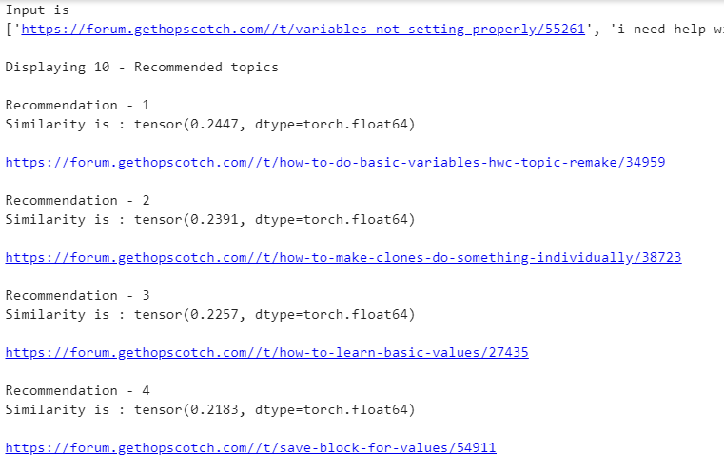
Results - TF-IDF Recommendation

Slide 38
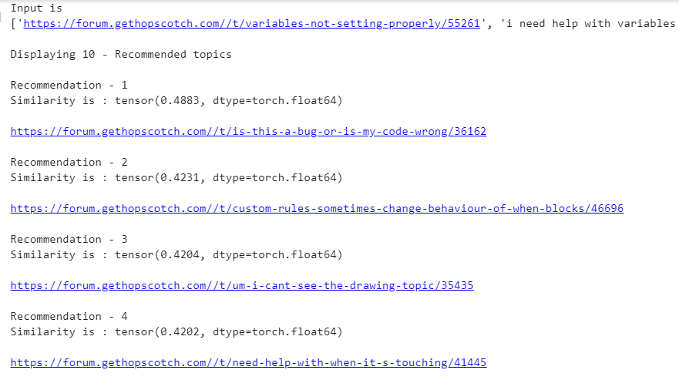
Results - Combined Approach

Slide 39
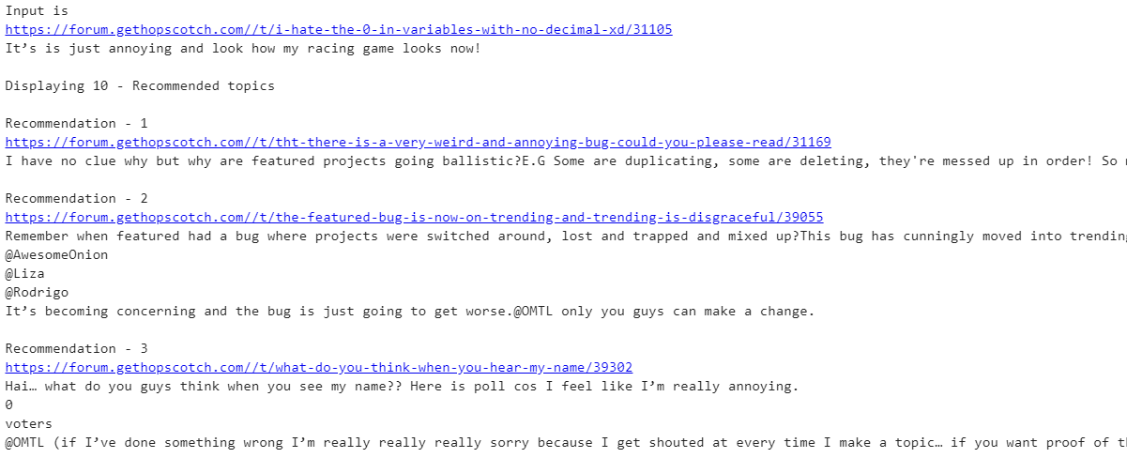
Results - BERT Recommendation

Slide 40
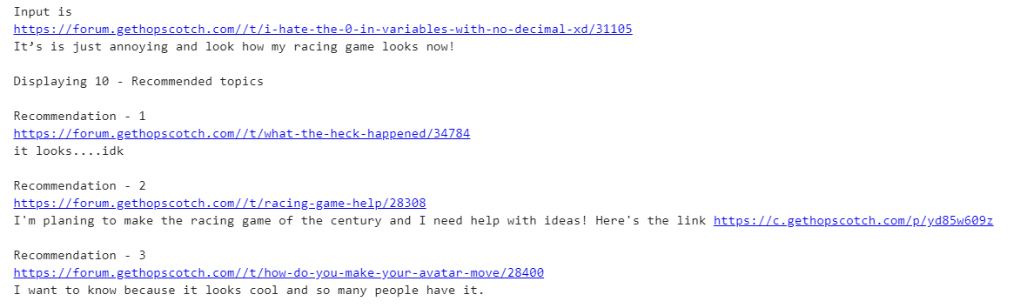
Results - TF-IDF Recommendation

Slide 41
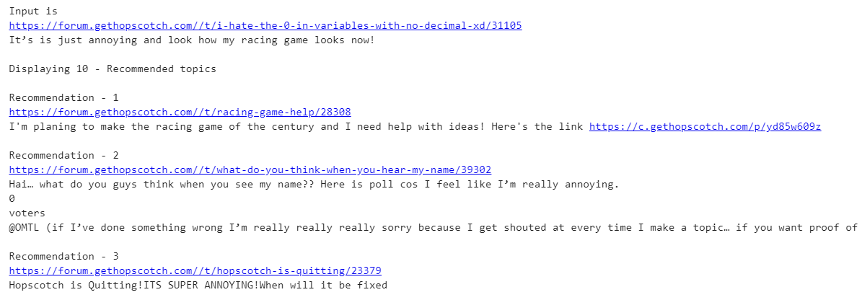
Results - Combined Approach

Slide 42
Category Automation

Slide 43
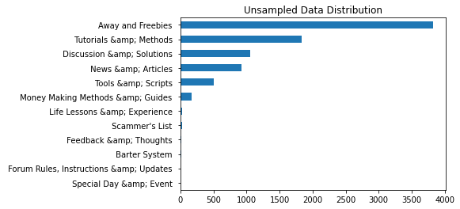
Data
One Hack Forum
Highly active
10,000 posts total of 12 categories.

Slide 44
Initial Steps
Scraped forum and extracted text, metadata from the posts.
Preprocessed the data and used a pre-trained BERT model for encoding sentences of input text.
Why BERT?

Slide 45
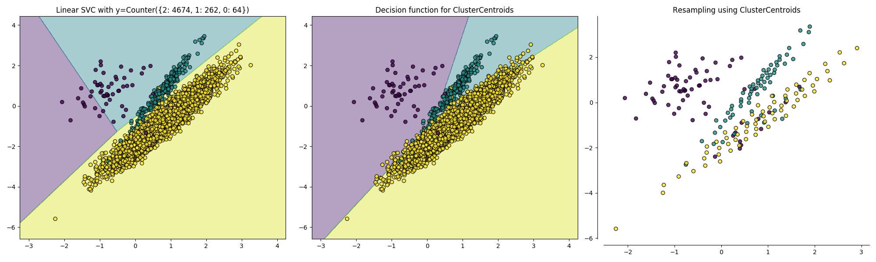
Sampling
We have tried to eliminate the problem of imbalanced data by sampling our data using Cluster Centroid based Majority Under-sampling Technique (CCMUT)

Slide 46
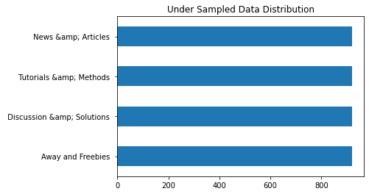
Under-Sampled Data

Slide 47
WorkFlow
Text
Pre-Trained BERT Model
Preprocessing
Training
One Hack Forum
Sampling
SVM
Encoded Text
Web Scraper
Data
Scaling
XGBoost
Dataset
Neural network
PCA
Categories

Slide 48
Prediction
Encoded Text
Pre-Trained BERT Model
Category Prediction
Text Input
Pretrained ML models

Slide 49
ML Models and their performance
Model | Avg. Accuracy
SVM (Kernel = RBF) | 82%
Neural Network (Feed Forward) | 85%
Convolutional Neural Network (CNN) | 84%
XGBoost | 82%

Slide 50
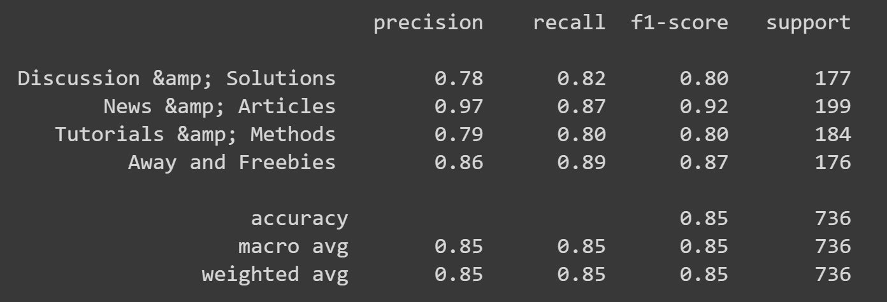
Classification Report

Slide 51
Next Steps

Slide 52
Future Work
Acquiring more data and figuring out approaches to handle the imbalanced Datasets.
Fine Tuning Pre-Trained Bert with CNN for superior classification.
Try different embedding approaches to deal with contextually similar categories of data.

Slide 53
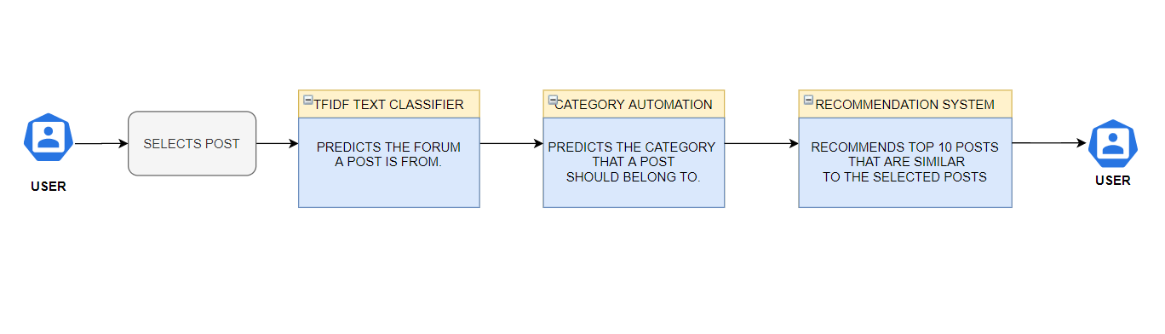
Future Implementation: Packaging

Slide 54
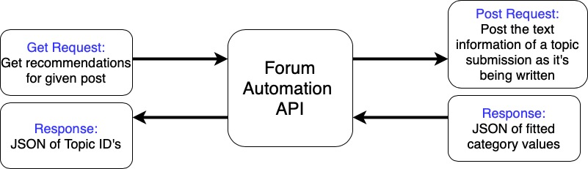
Future Implementation: Restful API
Can be easily built using Python’s Flask library
Hosted on AWS or other cloud service
Can be easily implemented into the backend of any Discourse forum

Slide 55
References
https://community.home-assistant.io/c/home-assistant
https://forums.gearboxsoftware.com/t/a-short-discourse-of-questions/10008
https://forum.gethopscotch.com/latest
https://onehack.us/
https://medium.com/analytics-vidhya/tf-idf-term-frequency-technique-easiest-explanation-for-text-classification-in-nlp-with-code-8ca3912e58c3
http://scikit-learn.sourceforge.net/0.7/modules/svm.html
https://syncedreview.com/2017/10/24/how-random-forest-algorithm-works-in-machine-learning/
https://thatware.co/naive-bayes/
https://hopscotchapp.fandom.com/wiki/Hopscotch_Wikia
https://choice.community/t/new-forum-web-interface/15634?page=2
https://en.wikipedia.org/wiki/Gearbox_Software
https://www.home-assistant.io/
https://onehack.us/

